Slide 1
CYBER SECURITY
AN ANALYSIS

Slide 2
AGENTA
Cyber security Computer virus Worm I LOVE YOU worm Trojan horse Ie0199.exe Trojan Trojan War Spams | Hacking Phishing Denial of Service (DoS) attack Man-in-the-Middle attacks Preventing network attacks Firewall Anti-virus scanners Cookies Guidelines for using computers over Internet

Slide 3
CYBERSECURITY
Cyber security refers to the protection of internet-connected systems, including hardware, software and sensitive information from theft or damage to their hardware, software or electronic data, as well as from disruption or misdirection of the services they provide.

Slide 4
COMPUTER VIRUS
Computer viruses are one of the most common forms of cyber attack, and they spread by replicating themselves and modifying other computer programs. Once a computer is infected, the virus can cause harm to the system and its files.

Slide 5
WORM
Worms are similar to viruses, but they spread over a network by exploiting vulnerabilities in the system. Unlike viruses, worms do not need human interaction to spread, making them more dangerous and harder to contain.

Slide 6
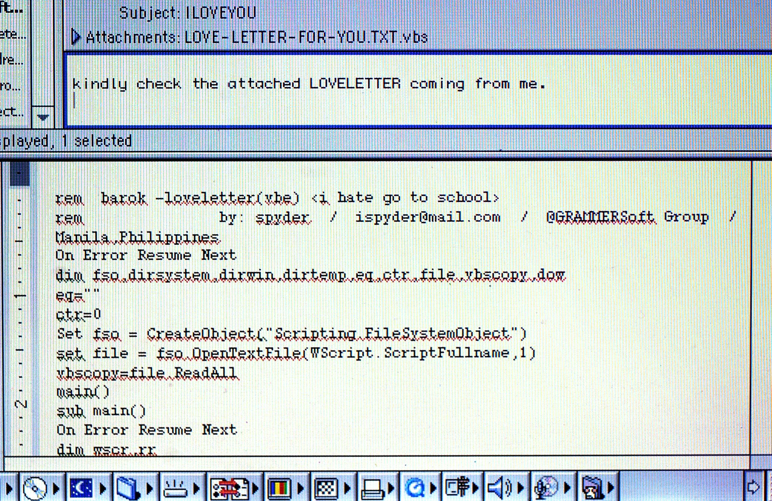
I LOVE YOU VIRUS
The I LOVE YOU worm was one of the most notorious computer worms in history, spreading rapidly via email in 2000 and causing significant damage to computer systems worldwide.

Slide 7
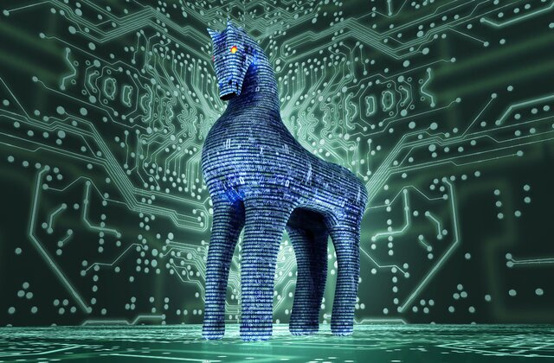
TROJAN HORSE
A Trojan horse is a type of malicious software that appears to be legitimate but has hidden functions that can harm the system or steal sensitive information. The Ie0199.exe Trojan is a specific example of a Trojan horse that can infect a computer and cause harm.

Slide 8
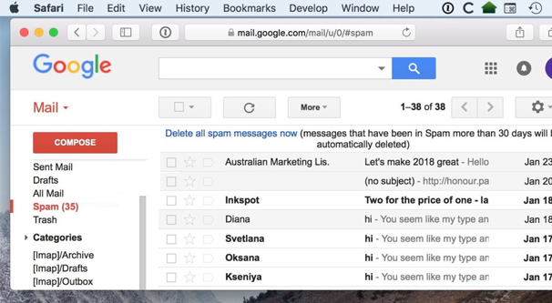
SPAM
Spam refers to unwanted or unsolicited email messages, typically sent in bulk for commercial purposes. These messages can not only be annoying but also pose a risk as they can contain malicious links or attachments..

Slide 9
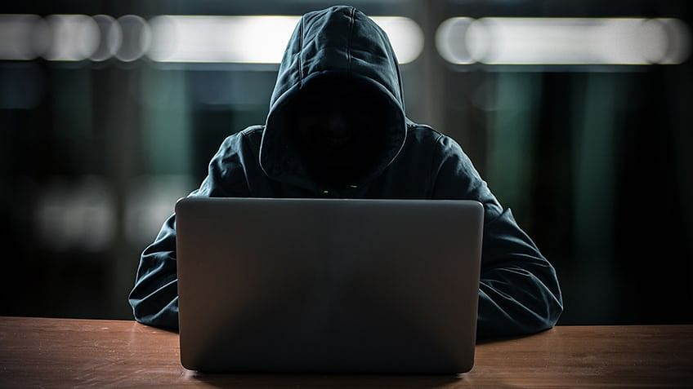
HACKING
Hacking involves unauthorized access to or manipulation of computer systems and networks, often with malicious intent. Hackers can use this access to steal sensitive information, manipulate systems, or cause harm.

Slide 10
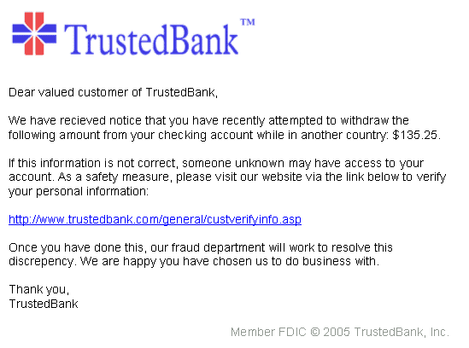
PHISHING
Phishing is a type of social engineering attack where the attacker attempts to trick the user into revealing sensitive information, such as passwords or credit card numbers, by posing as a trustworthy entity. These attacks often come in the form of emails or fake websites that mimic legitimate ones.

Slide 11
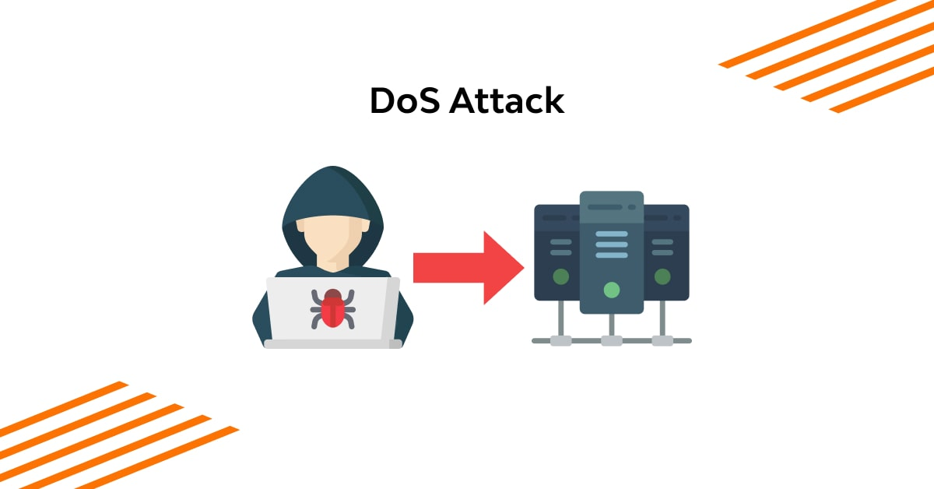
DoS(Denial Of Service) Attack
A Denial of Service (DoS) attack is an attempt to make a network resource unavailable to its intended users by overwhelming it with a flood of traffic from multiple sources. This can cause significant disruption and even bring down entire systems.

Slide 12
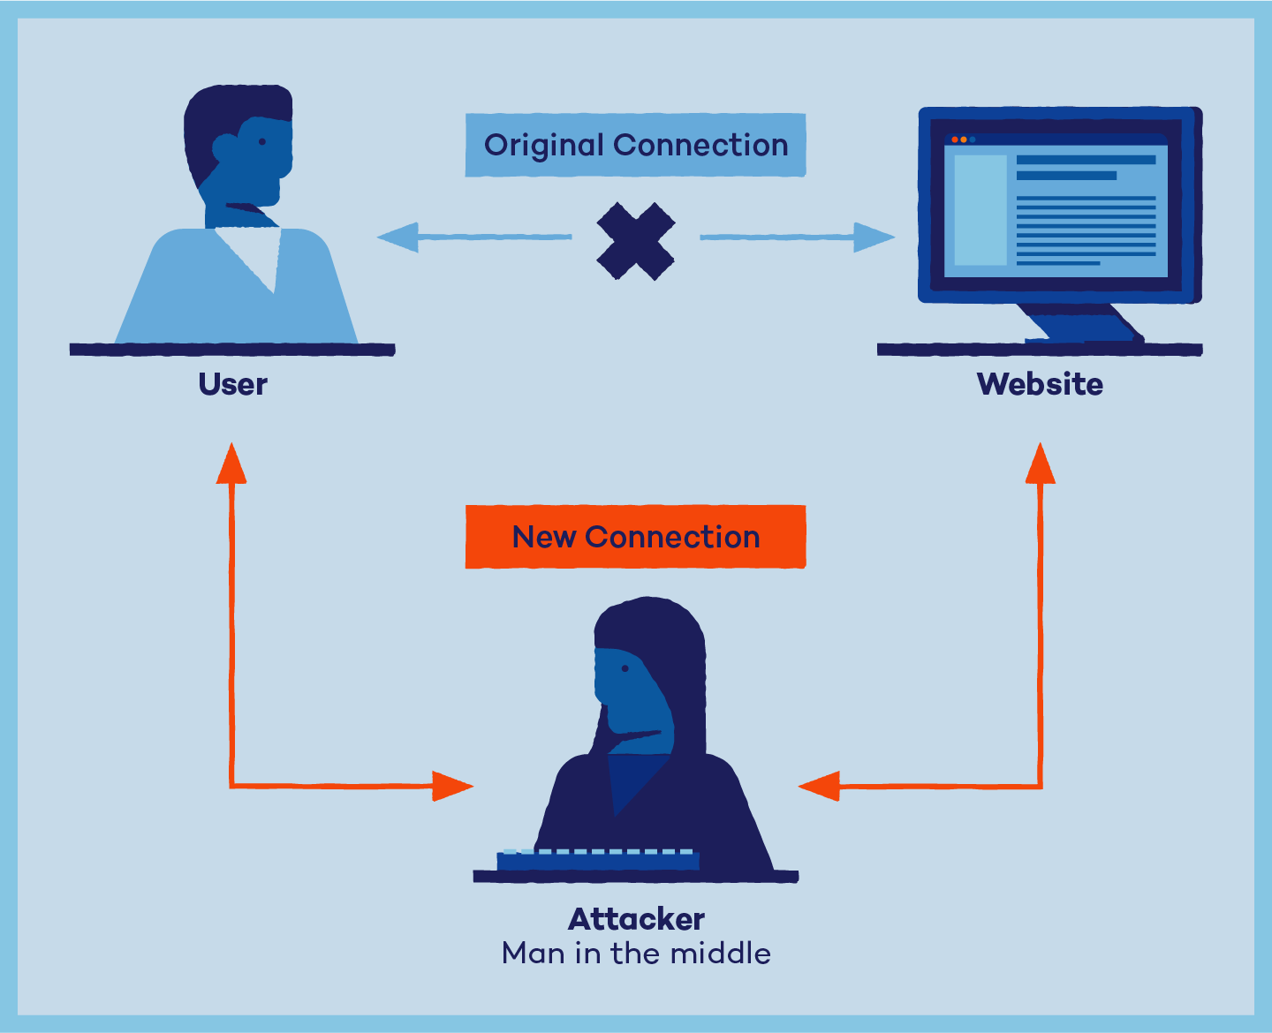
Man-in-the-Middle (MitM)
Man-in-the-Middle (MitM) attacks are another type of cyber attack where the attacker intercepts and manipulates communication between two parties. The attacker can use this to steal sensitive information, manipulate the communication, or cause harm.

Slide 13
HOW TO SECURE
HOW TO PREVENT CYBER ATTACKS

Slide 14
FIREWALL
A firewall is a security system that monitors and controls incoming and outgoing network traffic based on predetermined security rules.

Slide 15
ANTI-VIRUS SCANNERS
An antivirus is a program that protects a computer or network from viruses and other malicious software..

Slide 16
COOKIES
Cookies are small text files stored on a user's device that contain information about the user's browsing activity. They are used to remember user preferences and login information, and can be used for personalization and tracking purposes.

Slide 17
POINTS TO REMEMBER
Make sure the firewall is set and turned on.
Use strong passwords. Change passwords at regular intervals.
Update the virus definitions of your antivirus program periodically online.
Download files only from reputed sources.

Slide 18
THANKS
ANY QUESTIONS?

